Slide 1
The Anomalies of Symon's Rain Gauge in Community Based Rain Gauge Network
The Institution of Engineers (India) Student’s Chapter& ISTE Students Chapter
NMAM Institute Of Technology, Nitte-574110, Karkala Taluk
Technical Paper Presentation and Project Model Exhibition
“IEI_ISTE_NITTE-2018”
“Role of Engineers Towards Skill India Mission”
By
Mushtaq Ahmed
Naveen Kumar
Ajay.K
Students, Department of Civil Engineering
Shree Dharmasthala Manjunatheshwara Institute of Technology,Ujire-574240

Slide 2
Bird’s View
Introduction
History
Construction Methodology
Rainfall Measurement
Community-Based Network
Anomalies
References

Slide 3
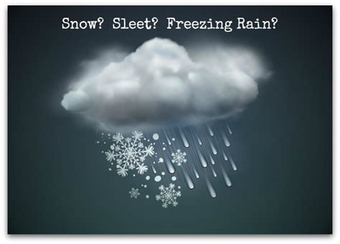
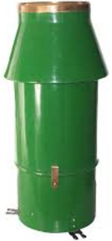
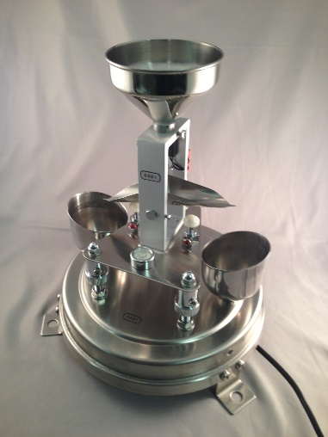

If There Is Any Magic In Earth It Lies In Rain…
Precipitation- Rain, Hail, Snow
Rain Gauge- A rain measuring device.
Types:
Non-Recording Raingauges
Recording Raingauges
Courtesy: Google Images

Slide 4

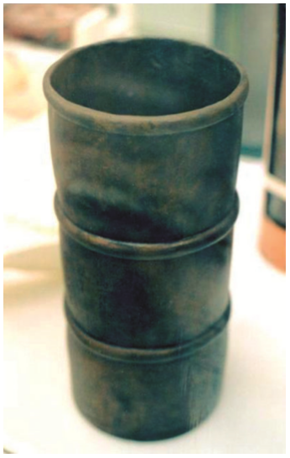
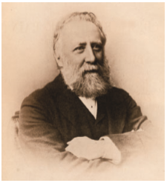
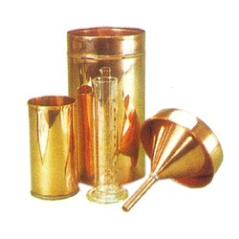
Varshanana
Document to first rainfall measurement is in Arthasastra by Kautilya in India in the 4th century BC.
“ A bowl with its mouth as wide as an Aratni [457 mm] shall be set up as a raingauge (Varshanana).
The quantity of rain that falls in the country of Jangala is 16 dronas” (Shamasastry, 1915)
The British Rainfall Organization, 1859–1919
George James Symons(1838-1900)
Courtesy: BritiIan Strangeways (2010), Google Images

Slide 5
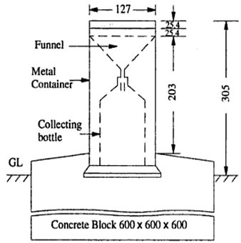
CONSTRUCTION

Slide 6

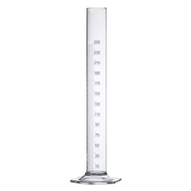

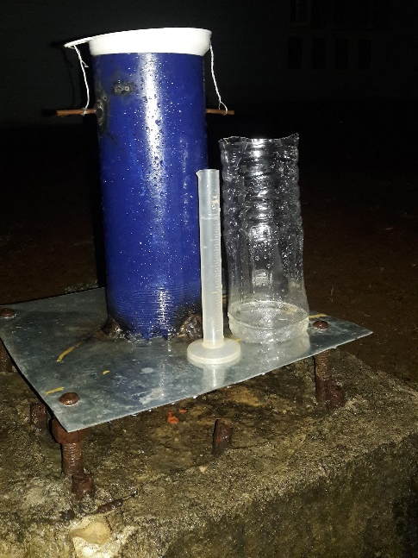
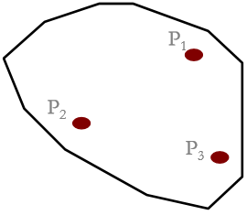

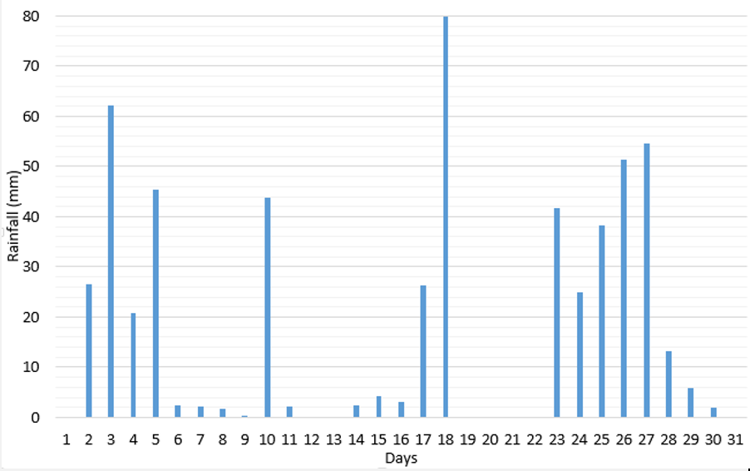
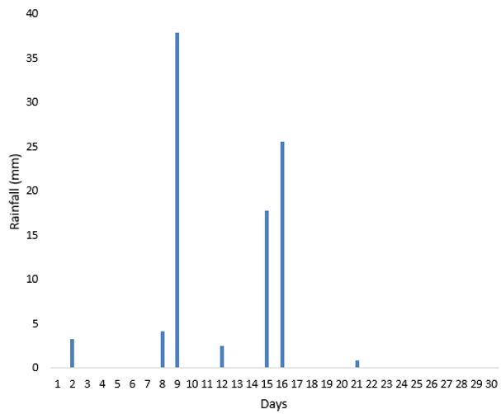
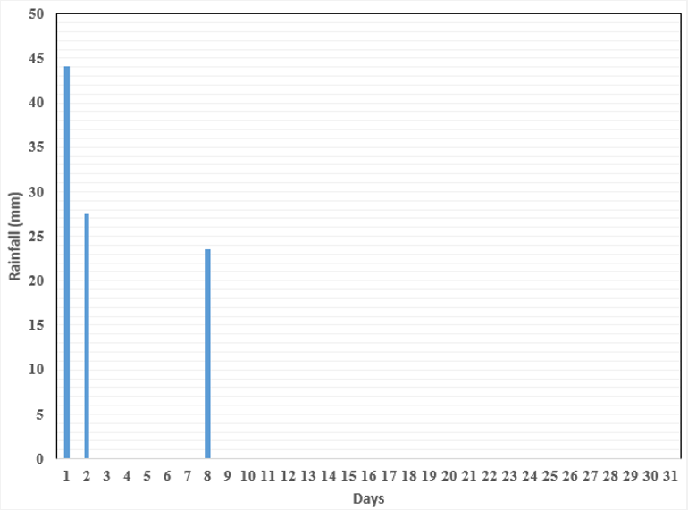
RAINFALL MEASUREMENT
Depth of rainfall=0.07874*Volume of rainfall
ARITHMATIC METHOD
where, Pi: Rainfall at ith raingauge station
N: Total no. of raingauge stations
August
September
October

Slide 7
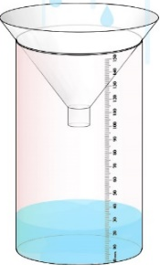


Community-Based Network System

Slide 8
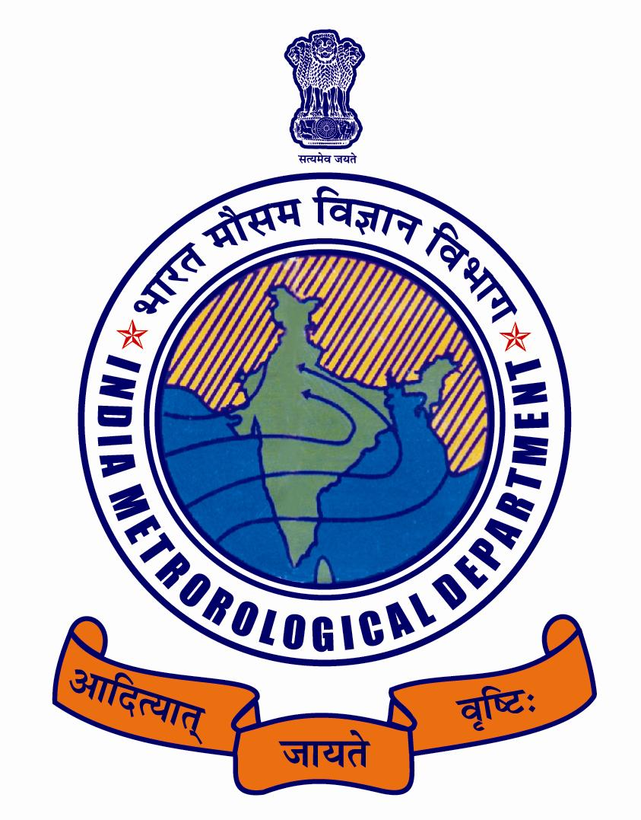



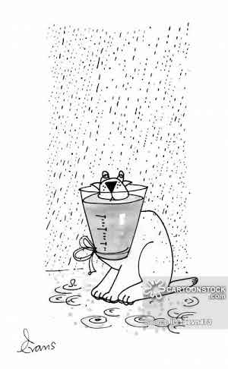


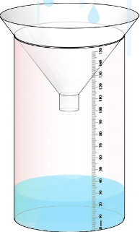
ANOMALIES

Slide 9
REFERENCES
[1] IS4986:2000 Indian Standard INSTALLATION OF RAINGAUGE (NON-RECORDING TYPE) AND MEASUREMENT OF RAIN — CODE OF PRACTICE (Second Revision ) ICS 17.060,
[2] IS 5225:1992 Indian Standard METEOROLOGY - RAINGAUGE, NON-RECORDING -SPECIFICATION ( First Revision ) UDC 551508.77
[3] Ian Strangeways (2010), A history of rain gauges, RMetS, Vol. 65, No.5
[4] Symons, G. J. (1867) Rain: how, when, where, why it is measured. Edward Stanford, London
[5] Reynolds G. 1965. A history of raingauges. Weather 20: 106–114.
[6] Burt S. 2010. Obituary – Ken Woodley. Weather 65: 27.
[7] Burton J. 1993. Pen portraits of Presidents – George James Symons. Weather 48: 75–77.
[8] Sergey. Y. Matrosov, Kurt A. Clark and Brooks E. Martner, Ali Tokay, (2002),X-Band Polarimetric Radar Measurements of Rainfall, American Meteorological Society, Vol 14 :941-942
[9] Legates,D.R, and C.J.Willmott, 1990:Mean seasonal and spatial variability in gauge-corrected global precipitation .Int.J. Climatol., 10: 941-952
[10] Amitai, E., 2000: Systematic variation of observed radar reﬂectivityrainfall rate relations in the tropics. J. Appl. Meteor., 39, 2198–2208
[11] Joyce, N. J. Cox and J. M. Kenworthy, 1868-70, Inferences regarding raingauge exposure at Durham.:85
[12] Salvatore Grimaldia,b,c,, Andrea Petrosellid, Luca Baldinie, Eugenio Gorguccie 2015, Description and preliminary results of a 100 square meter rain gauge Journal of Hydrology: 827-828
[13] http://www.nws.noaa.gov/om/coop/
[14] http://www.imd.gov.in/pages/serviceshydromet.php
[15] https://www.cocorah.org
[16] Google Images

